Slide 1

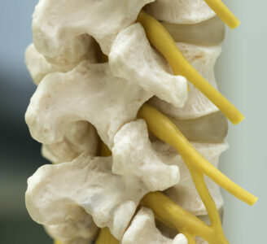
The spinal nerves
Al-Farabi Kazakh National University
Higher School of Medicine
https://drdavidchangmd.com/how-to-treat-compressed-spinal-nerves/

Slide 2
LEARNING OUTCOMES
As a result of the lesson you will be able to:
Describe the anatomy of nerves and ganglia in general;
Describe the attachments of a spinal nerve to a spinal cord;
Trace the branches of a spinal nerve distal to its attachments;
Name the five plexuses of a spinal nerves and describe their general anatomy;
Name some major nerves that arise from each plexus;
Explain the relationship of dermatomes to the spinal nerves.

Slide 3
1. Describe the anatomy of nerves and ganglia in general
A nerve
  is a cordlike organ composed of numerous nerve fibers (axons) bound together by connective tissue.
If we compare a nerve fiber to a wire carrying an electrical current in one direction, a nerve would be comparable to an electrical cable composed of thousands of wires carrying currents in opposite directions.

Slide 4
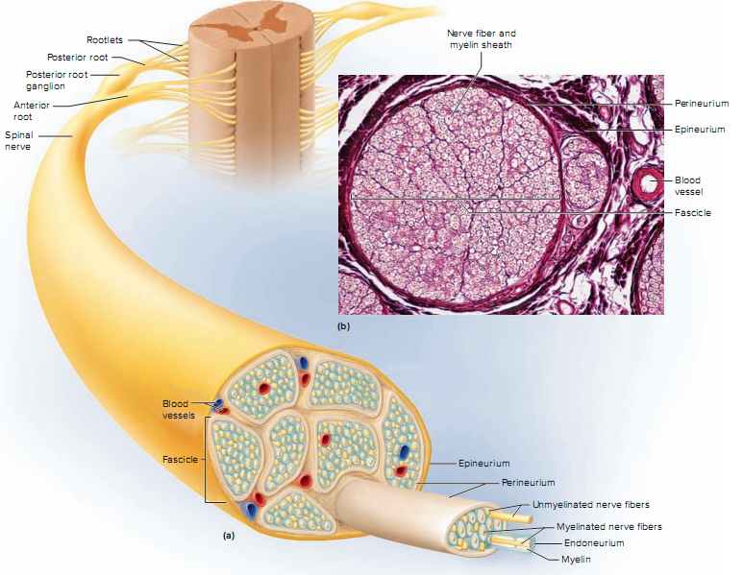

Slide 5
A nerve contains anywhere from a few nerve fibers to (in the optic nerve) a million.
Nerves usually have a pearly white color and resemble frayed string as they divide into smaller and smaller branches.
As we move away from the spinal nerves proper, the smaller branches are called peripheral nerves, and their disorders are collectively called peripheral neuropathy

Slide 6
Nerve fibers of the peripheral nervous system are ensheathed in Schwann cells, which form a neurilemma and often a myelin sheath around the axon.
External to the neurilemma, each fiber is surrounded by a basal lamina and then a thin sleeve of loose connective tissue called the endoneurium.
In most nerves, the fibers are gathered in bundles called fascicles, each wrapped in a sheath called the perineurium.
  The perineurium is composed of up to 20 layers of overlapping, squamous, epithelium like cells. Several fascicles are then bundled together and wrapped in an outer epineurium to compose the nerve as a whole.
  The epineurium consists of dense irregular connective tissue and protects the nerve from stretching and injury.
Nerves have a high metabolic rate and need a plentiful blood supply, which is furnished by blood vessels that penetrate these connective tissue coverings

Slide 7
How does the structure of a nerve compare to that of a skeletal muscle?
Which of the descriptive terms for nerves have similar counterparts in muscle histology?

Slide 8
As we know, peripheral nerve fibers are of two kinds:
https://da.wikipedia.org/wiki/Fil:Afferent_and_efferent_neurons_en.svg https://www.pinterest.com/pin/782641241468613248/
sensory (afferent) fibers carrying signals from sensory receptors to the CNS, and motor (efferent) fibers carrying signals from the CNS to muscles and glands.

Slide 9
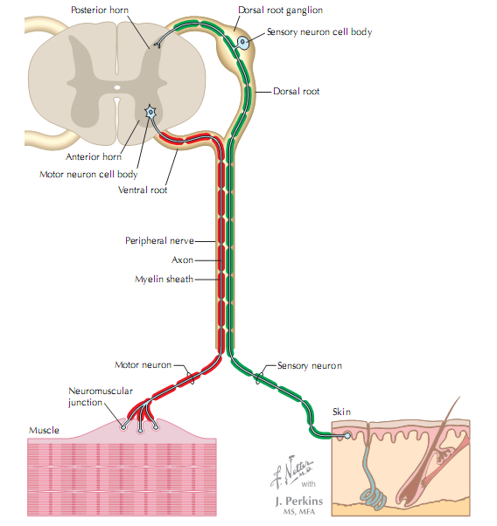

Netter’s essential physiology;2009

Slide 10
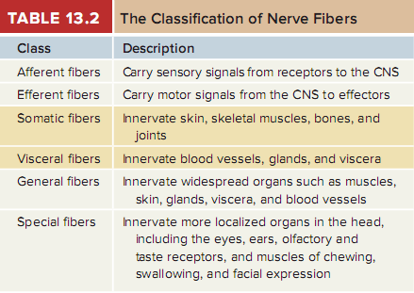
Both types can be classified as somatic or visceral and as general or special depending on the organs they innervate

Slide 11
Purely sensory nerves, composed only of afferent fibers, are rare;
  they include nerves for smell and vision.
Motor nerves carry only efferent fibers.
Most nerves, however, are mixed nerves,
  which consist of both afferent and efferent fibers and therefore conduct signals in two directions.
However, any one fiber in the nerve conducts signals in one direction only.
Many nerves commonly described as motor are actually mixed because they carry sensory signals of proprioception from the muscle back to the CNS.

Slide 12
If a nerve resembles a thread, a ganglion resembles a knot in the thread.
A ganglion is a cluster of neurosomas outside the CNS.
  It is enveloped in an epineurium continuous with that of the nerve.
  Among the neurosomas are bundles of nerve fibers leading into and out of the ganglion.

Slide 13
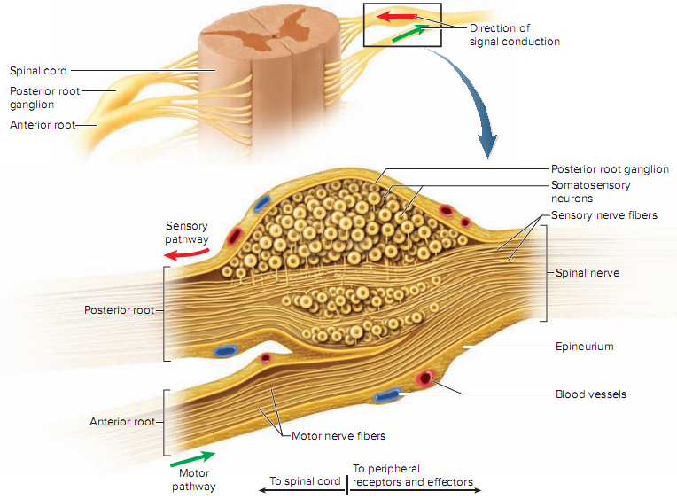
type of ganglion associated with the spinal nerves

Slide 14
2. Describe the attachments of a spinal nerve to the spinal cord
Spinal Nerves
There are 31 pairs of spinal nerves:
  8 cervical (C1–C8),
  12 thoracic (T1–T12),
  5 lumbar (L1–L5),
  5 sacral (S1–S5),
  and 1 coccygeal (Co1).

Slide 15
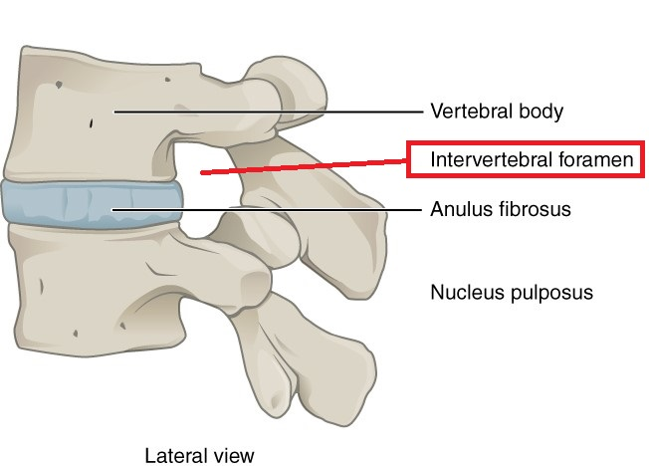
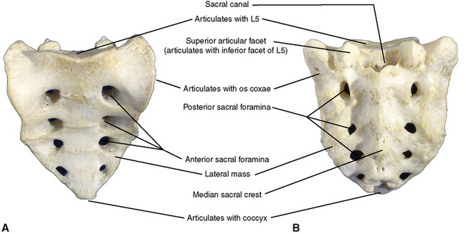
The first cervical nerve emerges between the skull and atlas, and the others emerge through intervertebral foramina, including the anterior and posterior foramina of the sacrum and the sacral hiatus.
https://radiopaedia.org/articles/intervertebral-foramen-1?lang=us
https://pocketdentistry.com/2-the-back/

Slide 16
Thus,
  spinal nerves C1 through C7 emerge superior to the correspondingly numbered vertebrae (nerve C5 above vertebra C5, for example);
  nerve C8 emerges inferior to vertebra C7; and below this,
  all the remaining nerves emerge inferior to the correspondingly numbered vertebrae (nerve L3 inferior to vertebra L3, for example).

Slide 17
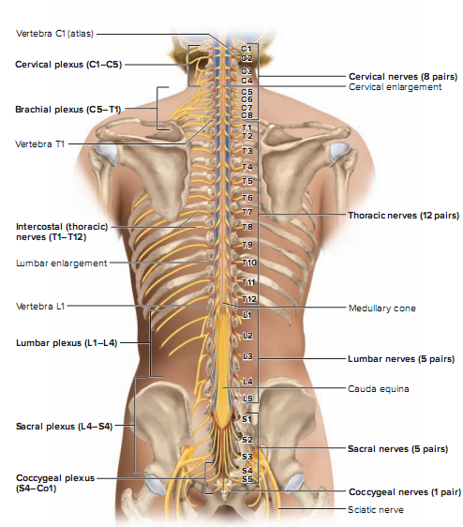

Slide 18
Proximal Branches
Each spinal nerve arises from two points of attachment to the spinal cord.
  In each segment of the cord, six to eight nerve rootlets emerge from the anterior surface and converge to form the anterior (ventral) root of the spinal nerve.
  Another six to eight rootlets emerge from the posterior surface and converge to form the posterior (dorsal) root.
  A short distance away from the spinal cord, the posterior root swells into a posterior (dorsal) root ganglion, which contains the somas of sensory neurons.
  There is no corresponding ganglion on the anterior root.

Slide 19
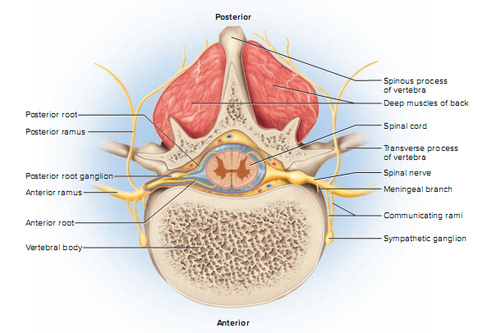

Slide 20
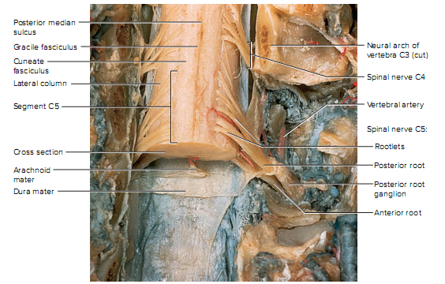

Slide 21
Slightly distal to the ganglion, the anterior and posterior roots merge, leave the dural sheath, and form the spinal nerve proper.
  The nerve then exits the vertebral canal through the intervertebral foramen.
The spinal nerve is a mixed nerve,
  carrying sensory signals to the spinal cord by way of the posterior root and ganglion,
  and motor signals out to more distant parts of the body by way of the anterior root.
The anterior and posterior roots are shortest in the cervical region and become longer inferiorly. The roots that arise from segments L2 to Co1 of the cord form the cauda equina. Some viruses invade the CNS by way of the spinal nerve roots.

Slide 22
3. Trace the branches of a spinal nerve distal to its attachments
Distal Branches
Distal to the vertebrae, the branches of a spinal nerve are more complex .
  Immediately after emerging from the intervertebral foramen, the nerve divides into an anterior ramus, posterior ramus, and a small meningeal branch.
Thus, each spinal nerve branches on both ends—into anterior and posterior roots approaching the spinal cord, and anterior and posterior rami leading away from the vertebral column.

Slide 23
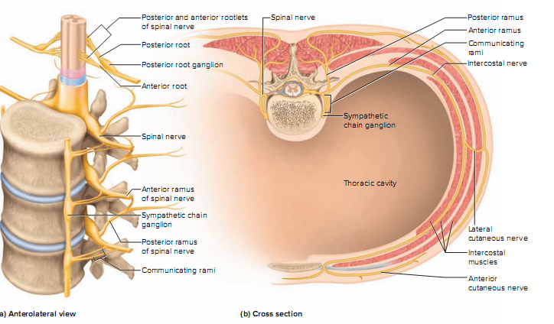

Slide 24
The meningeal branch reenters the vertebral canal and
  innervates the meninges, vertebrae, and spinal ligaments with sensory and motor fibers.
The posterior ramus
  innervates the muscles and joints in that region of the spine and the skin of the back.
The larger anterior ramus
  innervates the anterior and lateral skin and muscles of the trunk, and gives rise to nerves of the limbs.

Slide 25
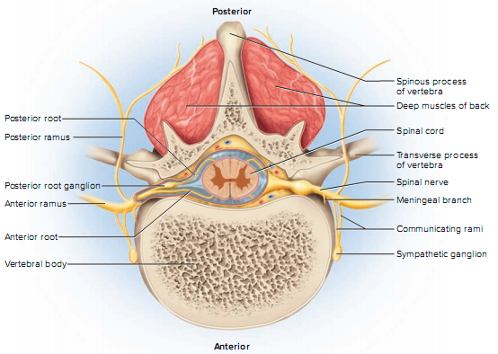

Slide 26
The anterior ramus differs from one region of the trunk to another.
  In the thoracic region, it forms an intercostal nerve, which travels along the inferior margin of a rib and innervates the skin and intercostal muscles (thus contributing to breathing).
  Sensory fibers of the intercostal nerve branches to the skin are the most common routes of viral migration in the painful disease known as shingles.
  Motor fibers of the intercostal nerves innervate the internal oblique, external oblique, and transverse abdominal muscles.
All other anterior rami form the nerve plexuses.

Slide 27
As shown in figure 13.13, the anterior ramus also gives off a pair of communicating rami,
  which connect with a string of sympathetic chain ganglia alongside the vertebral column.
These are seen only in spinal nerves T1 through L2. They are components of the sympathetic nervous system and are discussed more fully later.

Slide 28
4. Name the five plexus of spinal nerves and describe their general anatomy
Except in the thoracic region, the anterior rami branch and anastomose (merge) repeatedly to form five webs called nerve plexuses:
  the small cervical plexus in the neck,
  the brachial plexus near the shoulder,
  the lumbar plexus of the lower back,
  the sacral plexus immediately inferior to this,
  and finally, the tiny coccygeal plexus adjacent to the lower sacrum and coccyx.

Slide 30
The spinal nerve roots that give rise to each plexus are indicated in violet in each table (see below).
Some of these roots give rise to smaller branches called trunks, anterior divisions, posterior divisions, and cords, which are color-coded and explained in the individual tables below.
Two of the nerves arising from these plexuses, the radial and sciatic, are sites of unique nerve injuries described.

Slide 31
The nerves tabulated here have somatosensory and motor functions.
  Somatosensory means that they carry sensory signals from bones, joints, muscles, and the skin, in contrast to sensory input from the viscera or from special sense organs such as the eyes and ears.
  Somatosensory signals are for touch, heat, cold, stretch, pressure, pain, and other sensations.
One of the most important sensory roles of these nerves is proprioception, in which the brain receives information about body position and movements from nerve endings in the muscles, tendons, and joints.
  The brain uses this information to adjust muscle actions and thereby maintain equilibrium (balance) and coordination.

Slide 32
The motor function of these nerves is primarily to stimulate the contraction of skeletal muscles.
  They also innervate the bones of the corresponding regions,
  and carry autonomic fibers to some viscera and blood vessels, thus adjusting blood flow to local needs.

Slide 33
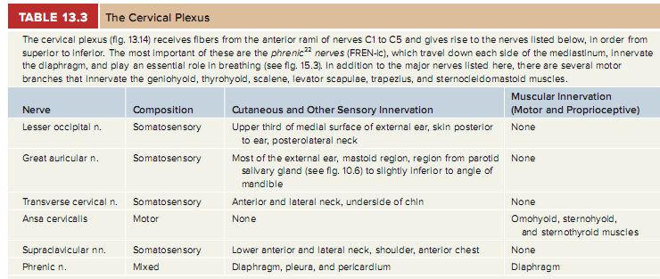
5. Name the some major nerves that arise from each plexus

Slide 34
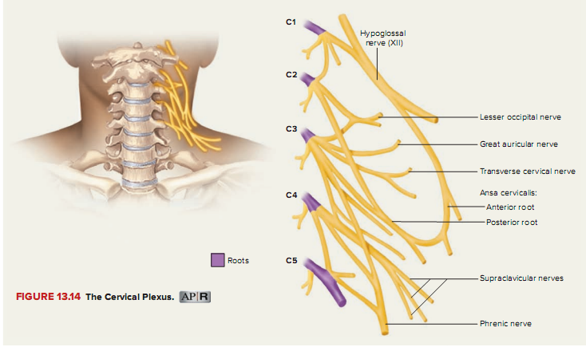

Slide 35
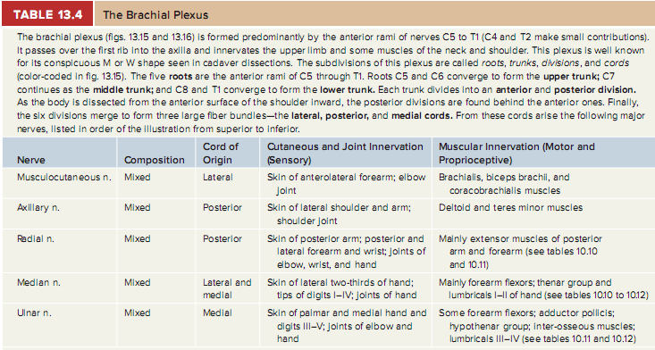

Slide 36
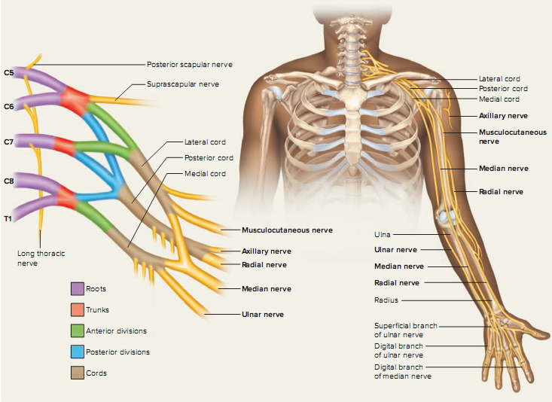

Slide 37
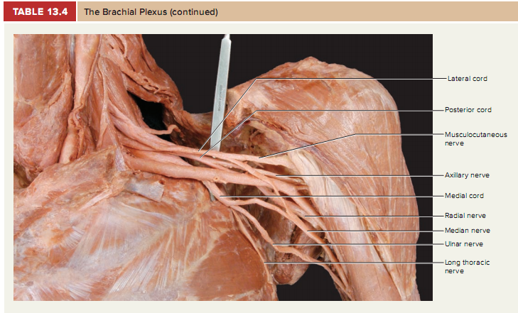

Slide 38
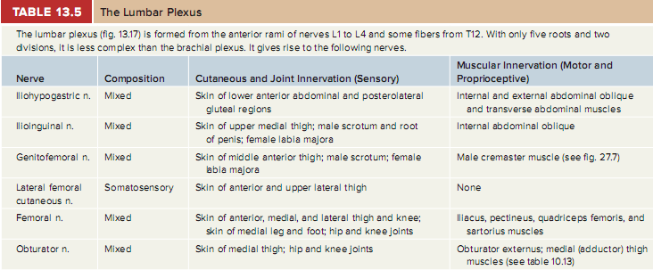

Slide 39
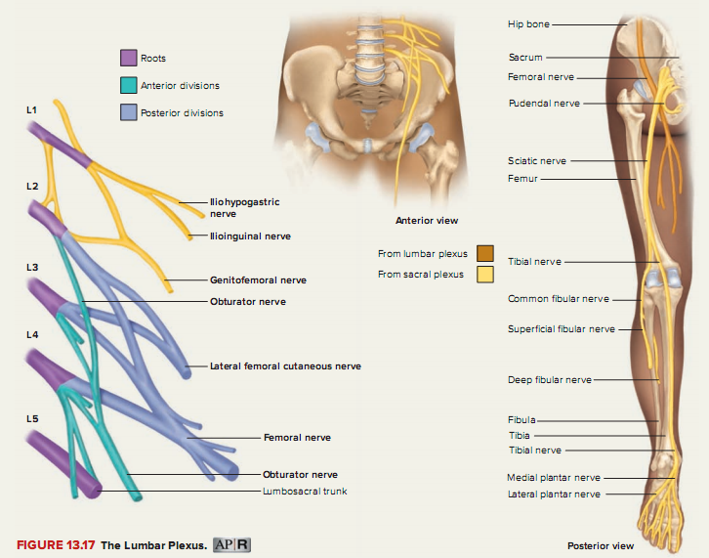

Slide 40
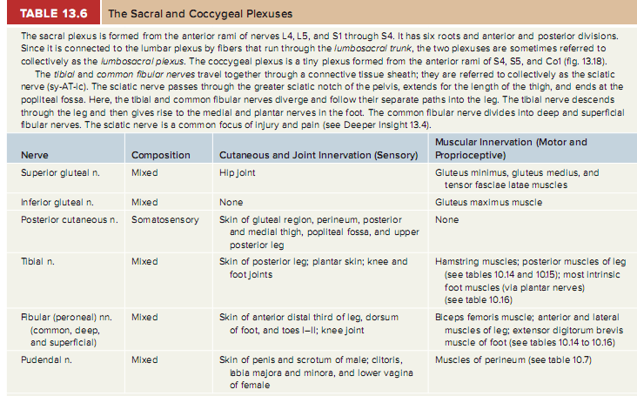

Slide 41
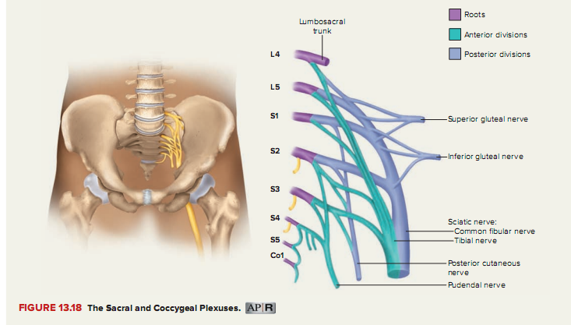

Slide 42
6. Explain the relationship of dermatomes to the spinal nerve
Each spinal nerve except C1 receives sensory input from a specific area of skin called a dermatome.
  A dermatome map is a diagram of the cutaneous regions innervated by each spinal nerve. Such a map is oversimplified, however, because the dermatomes overlap at their edges by as much as 50%.
Therefore, severance of one sensory nerve root does not entirely deaden sensation from a dermatome.
  It is necessary to sever or anesthetize three sequential spinal nerves to produce a total loss of sensation from one dermatome.
Spinal nerve damage is assessed by testing the dermatomes with pinpricks and noting areas in which the patient has no sensation.

Slide 43
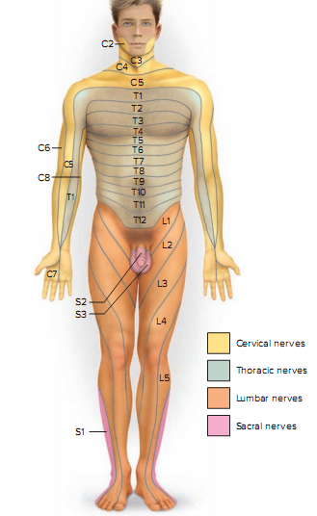

Dermatomes are a defined area of skin to which the sensory component of a spinal nerve is distributed to a specific spinal cord segment.
All dermatomes from the shoulders down relay their sensory information back to the CNS through spinal nerves.
Myotomes are similar in function to dermatomes, but carry motor stimuli.
They are responsible for segmental innervation of skeletal muscle. For example the diaphragm muscle, which is innervated by the C3, C4, and C5 spinal nerves; collectively they form the phrenic nerve.

Slide 44
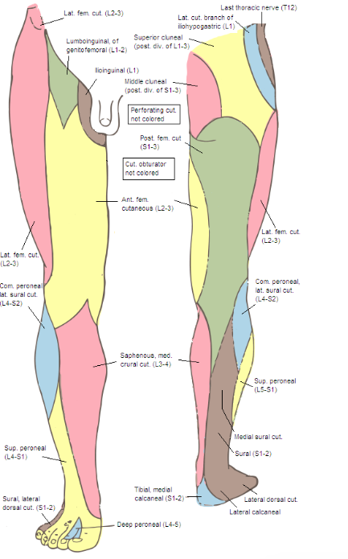
https://www.raynersmale.com/blog/2015/1/17/sensation-testing-for-person-with-peripheral-lesion

Slide 45
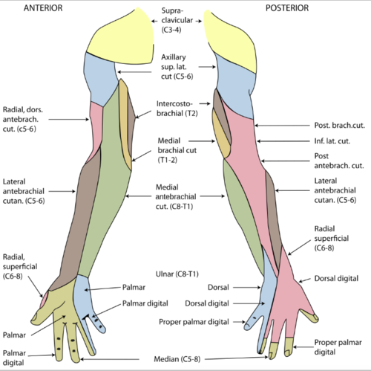
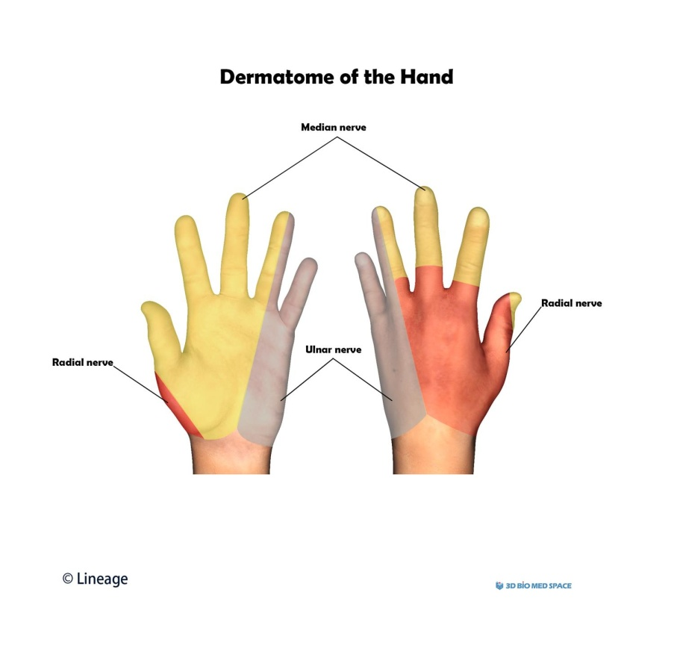
https://www.raynersmale.com/blog/2015/1/17/sensation-testing-for-person-with-peripheral-lesion

Slide 46
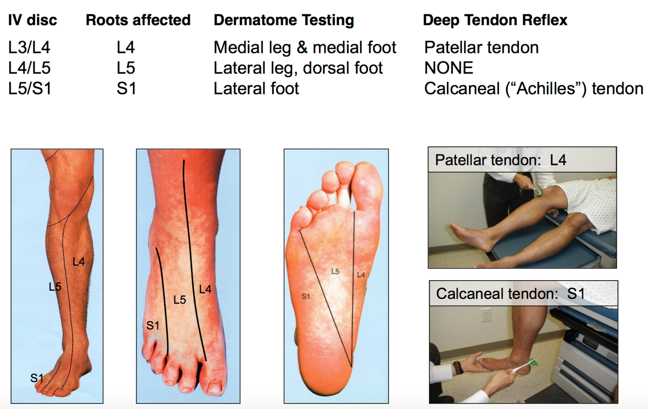
https://www.pinterest.com/pin/430586414368483642/

Slide 47
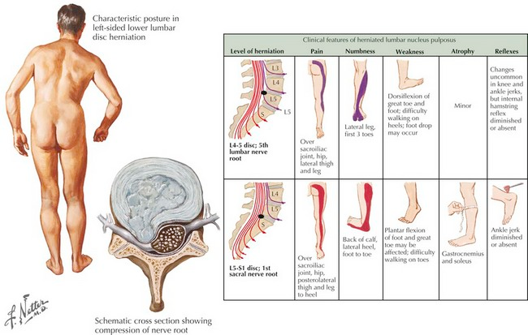
Sportsmen often have such symptoms (herniations – rare, protrusions more often)

